Slide 1

ICT-4257: Cryptography and Network Security
for
4th Year 2nd Semester of B.Sc (Honors) in ICT
Lecture File: 05
Digital Signature and Cryptographic Hash Function
Prepared by:
Professor K M Akkas Ali
akkas@juniv.edu, akkas_khan@yahoo.com
Institute of Information Technology (IIT)
Jahangirnagar University, Dhaka-1342

Slide 2
Lecture File-05:
Digital Signature & Hash Function
Topics to be Discussed
Digital Signature
To be familiar with the general idea behind digital signature
To define security services provided by a digital signature
To describe some applications of digital signatures
Cryptographic Hash Function
To introduce general ideas behind hash function
To discuss the usage and application of hash function
To know the desirable properties of a hash function

Slide 3
What is Digital Signature?
Digital signature is a digital code that can be attached to an electronically transmitted message that uniquely identifies the sender and provides the integrity of the message.
It was first proposed in 1976 by Whitfield Diffie of Stanford University.
Typically the signature is formed by taking the hash of the message (called message digest) and encrypting the digest with the creator’s private key.
The encrypted message digest is known as a digital signature.
The signature is then added at the end of each message that is to be sent to the recipient.
The recipient decrypts the signature using sender’s public key and verifies that the message digest is correct and the message has come from the genuine sender. If the transmitted message is changed, the digital signature is invalidated.
Like a written signature on a document, the purpose of a digital signature is to guarantee that the individual sending the message really is who he or she claims to be.

Slide 4
Process of Creating Digital Signature
The process of creating a digital signature is outlined below:
Sender generates a message.
He/she then creates a “digest” of the message using cryptographic hash function.
Sender encrypts the message digest with his/her private key for authentication. This encrypted message digest is called digital signature.
Sender attaches the digital signature to the end of the message that is to be sent. The message attached with digital signature is known as digitally signed message.
The sender encrypts the digitally signed message with the recipient’s public key and sends it to the recipient.
After receiving, the recipient decrypts the entire message with his/her private key.
The recipient detaches the message and digital signature.
He/she creates a “digest” of the received message using the same hash function the sender used.
The recipient decrypts the digital signature and finds the “digest” that the sender created.
The recipient then compares the two digests. If they are equal, the message is granted, otherwise it will be rejected.
Sender Site
Receiver Site
The processes are illustrated in the figure on the next slide..

Slide 5
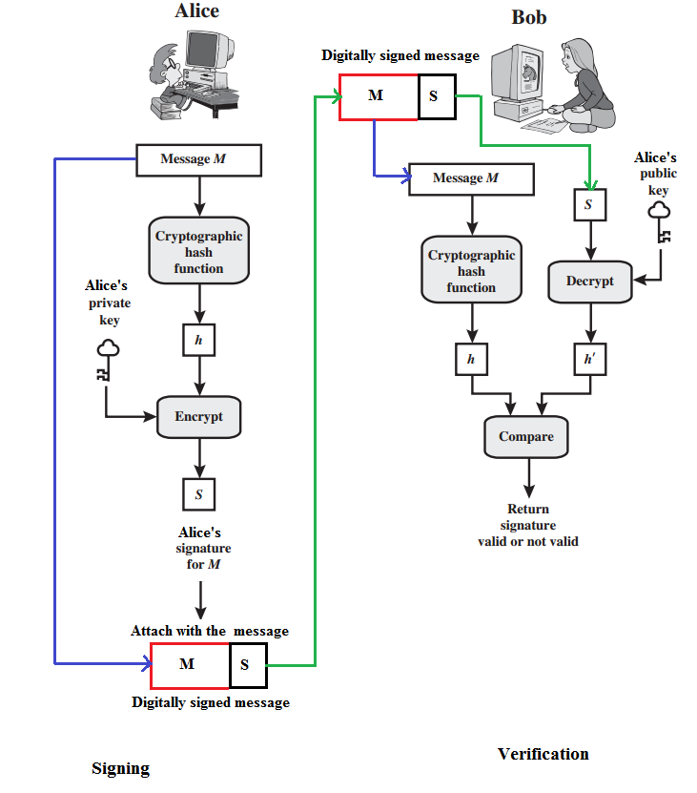
Digital Signature Process
Figure: Illustration of digital signature process:

Slide 7
Digital Signature Vs. Conventional Signature
Key-point | Conventional Signature | Digital Signature
Inclusion | a conventional signature is included in the document; it is part of the document. E.g., when we write a check, the signature is on the check; it is not a separate document. | But, when we sign a document digitally, we send the signature as a separate document.; a digital signature is a separate document. The sender sends two documents- the message and the signature. The recipient receives both documents and verifies that the signature belongs to the supposed sender. If this is proven, the message is kept; otherwise, it is rejected.
Verification method | A conventional signature on a document is verified by comparing the signature on it with the signature on file. | For a digital signature, the recipient receives the message and the signature. The recipient needs to apply a verification technique to the combination of the message and the signature to verify the authenticity.

Slide 8
Digital Signature Vs. Conventional Signature
Key-point | Conventional Signature | Digital Signature
Relationship | For a conventional signature, there is normally a one-to-many relationship between a signature and documents. A person uses the same signature to sign many documents. | For a digital signature, there is a one-to-one relationship between a signature and a message. Each message has its own signature. The signature on one message can not be used in another message. For example, if Bob receives two messages, one after another, from Alice, he can not use the signature of the first message to verify the second. Each message needs a new signature.
Duplicity | In conventional signature, a copy of the signed document can be distinguished from the original one on file. | In digital signature, there is no such distinction unless there is a factor of time (such as a timestamp) on the document. For example, suppose Alice sends a document instructing Bob to pay Eve. If the intercepts the documents and the signature, she can replay it later to get money again from Bob.

Slide 9
Services Provided by Digital Signature
A digital signature serves three important purposes:
Provides authentication of the sender
Verifies data integrity
Provides non-repudiation

Slide 10
Services Provided by Digital Signature
Message Authentication:
A digital signature’s main function is to verify that a message or document, in fact, comes from the claimed sender. That is, to provide authentication is the main function of digital signature.
Message Integrity:
The integrity of the message is preserved even if we sign the whole message because we cannot get the same signature if the message is changed. Therefore, digital signature provides the integrity of the message.
Non-Repudiation:
Attaching a digital signature with message prevents repudiation. This ensures that the sender should not be able to later deny that he/she sent a message. Non-repudiation prevents sender and vendor in a transaction or communication activity from later falsely denying that the transaction occurred.
N.B. As contrast to encryption scheme, digital signature does not provides the confidentiality of the message.

Slide 11
Digital Signature Vs. Cryptosystem
A digital signature needs an asymmetric-key cryptosystem. The signer signs the message with her private key; the verifier verifies it with the signer’s public key.
A cryptosystem uses the private and public keys of the receiver. On the other hand, a digital signature uses the private and public keys of the sender.
A digital signature does not provide confidential communication. But a cryptosystem can provide the confidentiality of a message.
A cryptosystem can not provide the authenticity of the message originator, but a digital signature can.

Slide 12
Message Authentication Code (MAC) Vs. Digital Signature
Is a message digest the same as a message authentication code?
A message authentication code (MAC) is a short piece of information used to authenticate a message.
A MAC algorithm accepts as input a secret key and a message to be authenticated.
It outputs a MAC, which is sometimes called a tag.
The MAC value protects both a message's integrity as well as its authenticity by allowing verifiers (who also possess the same secret key) to detect any changes to the message content.
A message authentication code is different than a digital signature.
MAC values are both generated and verified using the same secret key.
While using MAC, sender and receiver of a message must agree on keys before initiating communications. As is the case with private key encryption.
A message authentication code does not provide the property of non-repudiation offered by digital signature.

Slide 13
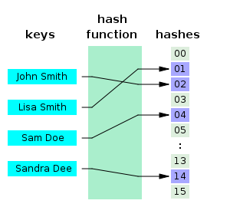
Hash Function
A hash function is a formula or an algorithm that-
takes large data sets of variable length as input, and
returns smaller data sets of fixed length as output.
Since, the output is smaller than the input data, a hash function compresses an n-bit message string to create an m-bit string where n is normally greater than m.
The values returned by a hash function are called hash values, hash codes, hash sums, checksums or simply hashes.
Hash function creates hash value in such a way that it is extremely unlikely that some other text will produce the same hash value.
A hash table (also called hash map) is used to implement an associative array that can map keys to values. A hash table uses a hash function to compute an index into an array of buckets or slots, from which the correct value can be found.

Slide 14
Cryptographic Hash Function
A cryptographic hash function is a hash function that takes an arbitrary block of data as input and returns a fixed-size bit string as output. The returned value is called the cryptographic hash value.
Cryptographic hash function creates hash value in such a way that any (accidental or intentional) change to the data will change the hash value. Therefore, it is extremely unlikely that some other text will produce the same hash value.
The data to be encoded are often called the message, and the hash value is sometimes called the message digest or simply digest.

Slide 15
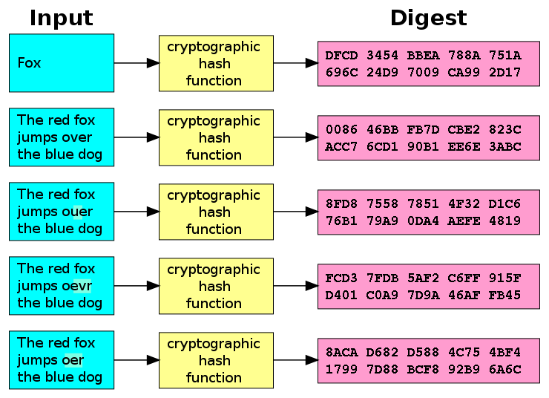
Cryptographic Hash Function
In cryptographic hash function, even a small changes in the input would cause a large change in the output.
Figure below shows how the slight changes input (here in the word "over") drastically change the resulting output.

Slide 16
Illustration: Cryptographic Hash Function
An illustration of the potential use of a cryptographic hash is as follows:
Alice poses a tough math problem to Bob and claims she has solved it.
Bob would like to try it himself, but would yet like to be sure that Alice is not bluffing. Therefore, Alice writes down her solution, computes its hash and tells Bob the hash value (whilst keeping the solution secret). Then, when Bob comes up with the solution himself a few days later, Alice can prove that she had the solution earlier by revealing it and having Bob hash it and check that it matches the hash value given to him before.

Slide 17
Use of Hash Function
Cryptographic hash functions have many information security applications, such as in-
digital signatures
message authentication codes (MACs)
other forms of authentication
Hash functions are primarily used to generate fixed-length output data that acts as a shortened reference to the original data. This is useful when the output data is too cumbersome to use in its entirety.
For example, consider a list of person’s names. Here, name of each person is of variable length. Searching for a person's name in the list is slow; time required to retrieve each name may also vary. But if each name could be hashed to a fixed length integer, then searching and retrieving each name will be performed in faster with constant time.
Hash functions are also used to accelerate table lookup or data comparison tasks such as finding items in a database, detecting duplicated or similar records in a large file, finding similar stretches in DNA sequences, and so on.

Slide 18
Hash Functions Used in Cryptography
The two commonly used hash functions are MD5 and SHA-1.
MD5:
MD stands for Message Digest.
Several MD hash algorithms designed by Ron Rivest are MD2, MD4 and MD5.
The last version MD5 is more secured than the previous versions.
It divides the message into blocks of 512 bits and creates a 128-bit digest.
SHA-1:
SHA stands for Secure Hash Algorithm.
This standard was developed by NIST (National Institute of Standards and Technology).
This standard is mostly based on MD5.
Several versions of SHA standard were realsed: SHA-1, SHA-224, SHA-256, SHA-384 and SHA-512.
SHA-1 returns a string of 160 bits.
Both MD5 and SHA-1 hash functions are built with the Merkle-Damgard construction.

Slide 19
Application of Hash Function in Cryptography
Hash functions are used for:
Verifying the integrity of message and file
Verifying password for secure login
fingerprints of keys
authentication
digital signatures
Verifying the integrity of files or messages:
An important application of secure hashes is verification of message integrity. Determining whether any changes have been made to a message (or a file), for example, can be accomplished by comparing message digests calculated before, and after, transmission (or any other event).
For this reason, most digital signature algorithms only confirm the authenticity of a hashed digest of the message to be "signed". Verifying the authenticity of a hashed digest of the message is considered proof that the message itself is authentic.

Slide 20
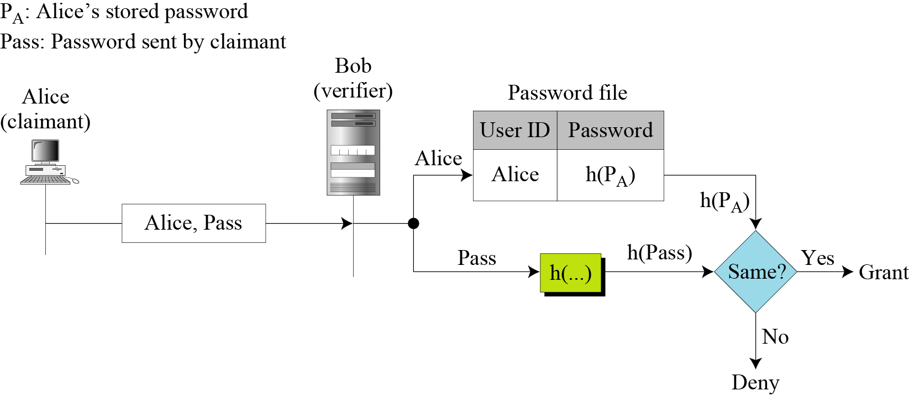
Application of Hash Function in Cryptography
Verifying password for secure login:
A related application of hash function is password verification.
Storing all user passwords as plaintext character can result in a massive security breach if the password file is compromised.
One way to reduce this danger is to only store the hash digest of each password instead of the plaintext password in the table (a file) that is stored by user identification.
Any user can read the contents of the file, but, because the hash function is a one-way function, it is almost impossible to guess the value of the password.
When the password is created , the system hashes it and stores the hash in the password file.
When the user sends her user ID and password, the system creates a hash of the password and then compare the hash value with the one stored in the file.
If there is a match, the user is granted access; otherwise, access is denied.

Slide 21
Application of Hash Function in Cryptography
File or data identifier:
A message digest can also serve as a means of reliably identifying a file;
One of the main applications of a hash function is to allow the fast look-up of a data in a hash table. Being hash functions of a particular kind, cryptographic hash functions lend themselves well to this application too.
Authentication:
Authentication is the assurance that the communicating entity is the one that it claims to be.
Cryptographic hash function can be used for provide authentication.

Slide 22
Application of Hash Function in Cryptography
Digital Signature:
Digital signature, first proposed in 1976 by Whitfield Diffie of Stanford University, is a digital code (encrypted message digest) that can be attached to an electronically transmitted message that uniquely identifies the sender.
Like a written signature, the purpose of a digital signature is to guarantee that the individual sending the message really is who he or she claims to be. It is linked to the data in such a manner that if the data is changed, the digital signature is invalidated.
When making a digital signature, cryptographic hash functions are generally used to construct the message digest.
A digital signature servers three important purposes:
Verifies data integrity.
Provides authentication of the sender.
Provides non-repudiation

Slide 23
Properties of Cryptographic Hash Function
A cryptographic hash function must be able to withstand all known types of cryptanalytic attack.
A desirable cryptographic hash function should have the following properties:
A hash function produces a fixed length value from a variable length source.
It is easy to compute the hash value for any given message.
Pre-image resistance: Given a hash h, it should be difficult to find any message m such that h = hash(m). That is, it is infeasible to generate a message that has a given hash.
A function with this property is called a one-way function.
Functions that lack this property are vulnerable to preimage attacks.
Second pre-image resistance: Given a message m₁, it should be difficult to find another message m₂ such that m1 ≠ m2 and hash(m1) = hash(m2).
Functions that lack this property are vulnerable to second-preimage attacks.
It is infeasible to modify a message without changing the hash.

Slide 24
Properties of Cryptographic Hash Function
Collision resistance: It should be difficult to find two different messages m₁ and m₂ with the same hash h. Such a pair is called a cryptographic hash collision.
This property is sometimes referred to as strong collision resistance. It requires a hash value at least twice as long as that required for preimage-resistance; otherwise collisions may be found by a birthday attack.
A hash function must be referentially transparent, i.e., if called twice on input that is "equal" (for example, strings that consist of the same sequence of characters), it should give the same result.
A hash procedure must be deterministic—meaning that for a given input value, it must always generate the same hash value.
Hash functions are destructive, as the original data is lost when hashed.
A small change in the input m would cause a large change in the output of the hash function.
It should be impossible for an adversary to find two messages with substantially similar digests; or to infer any useful information about the data, given only its digest. Therefore, a cryptographic hash function should behave as much as possible like a random function while still being deterministic and efficiently computable.
The above properties of a cryptographic hash function imply that a malicious adversary cannot replace or modify the input data without changing its digest. Thus, if two strings have the same digest, one can be very confident that they are identical.

Slide 25
Simple Hash Function
Some Popular Hash Function:
Here are some relatively simple hash functions that have been used:
Division-remainder method
Mid-square method
Folding method
Division-remainder method:
Using this method, choose a number m that is larger than the number n of keys in K (K is a set of keys). Generally, the number m is chosen to be a prime number. The hash function H is defined as:
H(k)= k (mod m) or, H(k)= k (mod m)+1
Here k (mod m) denotes the remainder when k is divided by m.
The second formula is used when we want the hash addresses to range from 1 to m rather than from 0 to m-1.

Slide 26
Simple Hash Function
Example: Division-remainder method:
Suppose a company with 68 employees assigned a 4-digit employee number to each employee which is used as the primary key. Apply the division method of hash function to each of the following employee number:
3205, 7148, 2345
Solution:
Since, there are 68 employees in the company, two digit employee number is sufficient to represent them.
Highest 2 digit number is 99 and 97 is the nearest 2 digit prime number of 99. So, we divide each of the 4 digit employee number by 97.
H(3205)= 3205 (mod 97)= 04.
H(7148)= 7148 (mod 97)= 67
H(2345)= 2345 (mod 97)= 17
In the case that the memory addresses begin with 01 rather than 00, we choose that the function H(k) = k(mod m)+1 to obtain. H(3205)= 3205 (mod 97)+1= 4+1=05

Slide 27
Simple Hash Function
Mid-square method:
Using this method, the key k is squared. Then the hash function H is defined by:
H(k)=l,
Where l is obtained by deleting digits from both ends of k².
Example: Mid-square method
Suppose a company with 68 employees assigned a 4-digit employee number to each employee which is used as the primary key. Apply the mid-square method of hash function to each of the following employee number:
3205, 7148, 2345
Solution:
Observe that the 4th and 5th digits counting from right are chosen for the hash address.
K | 3205 | 7148 | 2345
K² | 10272025 | 51093904 | 5499025
H(k) = I | 72 | 93 | 99

Slide 28
Simple Hash Function
Folding method:
Using this method, the key k is portioned into a number of parts, k₁, k₂, k₃, …..k_{r}, where each part, except possibly the last, has the same number of digits as the required address. Then the parts are added together, ignoring the last carry if any. That is:
H(k)=k₁+k₂+k₃+…..+k_{r} , where the leading-digit carries, if any, are ignored.
Example: Folding method
Suppose a company with 68 employees assigned a 4-digit employee number to each employee which is used as the primary key. Apply the folding method of hash function to each of the following employee number:
3205, 7148, 2345
Solution:
Chop the key into two parts and then add them.
Observed that the leading digit from the 2nd function is ignored.
Alternatively, reverse folding method may be used as:
H(3205)= 32+50=82
K | 3205 | 7148 | 2345
H(k)=K₁+k₂ | 32+05=37 | 71+48=119 | 23+45=77
H(k) | 37 | 19 | 77

Slide 29
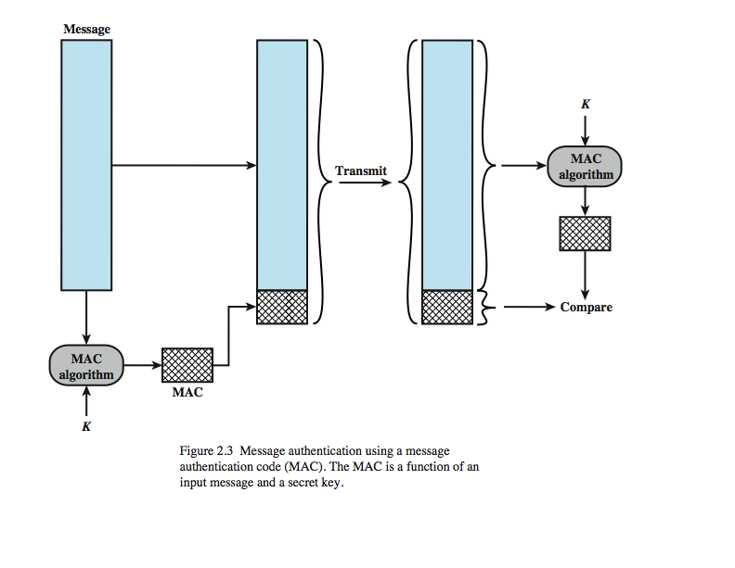
Message Authentication Code (MAC) Vs. Hash Code
MAC is a technique for message authentication which involves the use of a secret key to generate from a small block of data, known as a message authentication code, that is appended to the message.
This technique assumes that two communicating parties, say Alice and Bob, share a common secret key K_{AB}. When Alice has a message to send to Bob, she calculates the message authentication code as a complex function of the message and the key: MAC_{M} = F(K_{AB}, M).
The message plus code are transmitted to the intended recipient.
The recipient performs the same calculation on the received message, using the same secret key, to generate a new message authentication code.
The received code is compared to the calculated code.

Slide 30
Message Authentication Code (MAC) Vs. Hash Code
If we assume that only the receiver and the sender know the identity of the secret key, and if the received code matches the calculated code, then
The receiver is assured that the message has not been altered.
If an attacker alters the message but does not alter the code, then the receiver’s calculation of the code will differ from the received code.
Because the attacker is assumed not to know the secret key, the attacker cannot alter the code to correspond to the alterations in the message.
The receiver is assured that the message is from the alleged sender.
Because no one else knows the secret key, no one else could prepare a message with a proper code.
If the message includes a sequence number (such as is used with X.25, HDLC, and TCP), then the receiver can be assured of the proper sequence, because an attacker cannot successfully alter the sequence number.

Slide 31
Message Authentication Code (MAC) Vs. Hash Code
An alternative to the message authentication code is the one-way hash function.
A hash function accepts a variable-size message M as input and produces a fixed-size message digest H(M) as output. The purpose of a hash function is to produce a “fingerprint” of a file, message, or other block of data.
Typically, the message is padded out to an integer multiple of some fixed length (e.g., 1024 bits) and the padding includes the value of the length of the original message in bits.
Unlike the MAC, a hash function does not take a secret key as input. To authenticate a message, the message digest is sent with the message in such a way that the message digest is authentic.

Slide 32
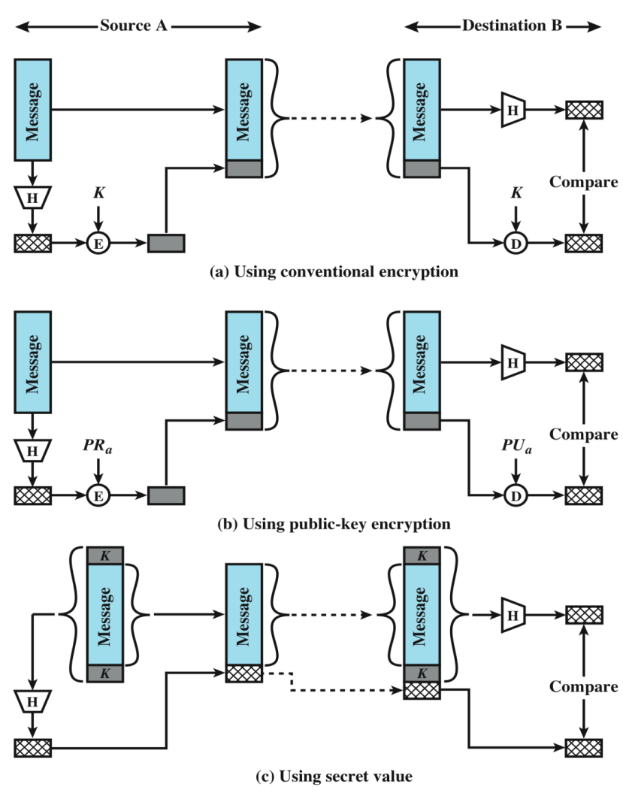
Message Authentication Code (MAC) Vs. Hash Code
Figure below illustrates three ways in which the message can be authenticated using a hash code.
The message digest can be encrypted using symmetric key encryption (part a); if it is assumed that only the sender and receiver share the encryption key, then authenticity is assured.
The message digest can also be encrypted using public-key encryption (part b);
Part c illustrate a technique, known as a keyed hash MAC where authentication is done without using encryption. It assumes that two communicating parties, say A and B, share a common secret key K which is incorporated into the process of generating a hash code.
When A has a message to send to B, it calculates the hash function over the concatenation of the secret key and the message: MDM = H(KMK). It then sends [ MMDM] to B. Because B possesses K, it can recompute H(KMK) and verify MDM. Because the secret key itself is not sent, it should not be possible for an attacker to modify an intercepted message. As long as the secret key remains secret, it should not be possible for an attacker to generate a false message.

Slide 33
Discussion Points
Digital Signature
To be familiar with the general idea behind digital signature
To define security services provided by a digital signature
To describe some applications of digital signatures
Cryptographic Hash Function
To introduce general ideas behind hash function
To discuss the usage and application of hash function
To know the desirable properties of a hash function

Slide 34

Have a question?
Thank you…

